Slide 1
Northwest Territories Emergency Management System Overview
September 2019

Slide 2
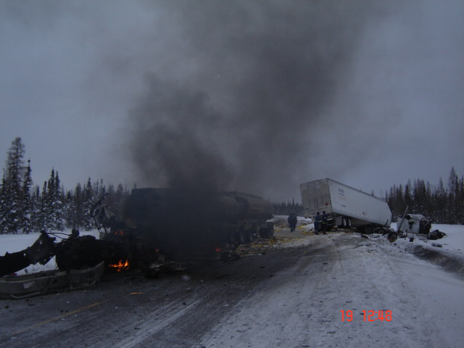
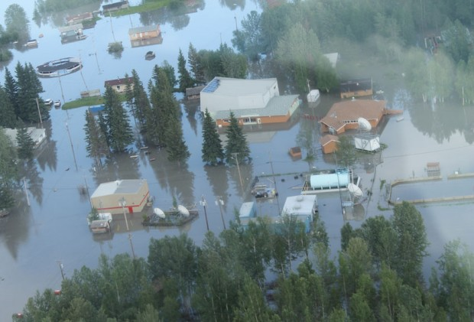
Emergencies
Emergency: a current or imminent event that requires prompt coordination of action or special regulation of persons or property in order to protect the safety, health or welfare of people or to limit or prevent damage to property or the environment.
Notes:
Pictures:
Highway 3 Accident – February 2013
Nahanni Butte flood – June 2012
For the purposes of emergency management, this is the definition we use.
An emergency can be complex and involve a network of first responders with many responsibilities which could require excessive resources. Emergencies should not be confused with incidents and needs to be compared to the term disaster as some jurisdictions may use this term in a slightly different sense.
Incidents are events that community services (fire, police, EMS, utility companies and parts of industry) respond to on a routine basis under normal operating conditions. For example, the police address public security issues and the fire department responds to community fires. These should not be considered emergencies because those organizations have the response capacity including the expertise and resources to address those incidents.
Disaster is another term commonly used when discussing emergencies. There are varying definitions of this term however, for simplicity, consider it an emergency that has exceeded the response capacity and/or requires external resources.

Slide 3
Emergency Management
The steps we take to prevent or reduce the impact, to prepare for, deal with and recover from emergencies and disasters.
Notes:
Emergency management is the universal term for the systems and processes for mitigating, preparing for, responding to and recovering from emergencies and disasters.

Slide 4
Emergency Management System
Key Components
Emergency Management Act
NWT Emergency Plan
Territorial Planning Committee
Emergency Management Organization
Territorial EMO and EOC
Regional EMOs and EOCs
Community EMOs, Plans and EOCs

Slide 5
Emergency Management Act
The Emergency Management Act provides the foundation for emergency management in the NWT. The Act outlines the duties and responsibilities of the Minister, EMO and community governments in preparing for and responding to emergencies.

Slide 6
Emergency Management Act
Powers and duties of Minister and Local Authorities
Establishment of an Emergency Management Organization
Head of EMO
Powers and duties
Establishment of a Territorial Planning Committee
Declaration of States of Emergency (Local and Territorial)
Direction and control of emergency operations
Extraordinary powers

Slide 7
NWT Emergency Plan
Provides the structure and guidelines on how the GNWT and its partners work together to support community governments and meet a collective responsibility in responding to territorial emergencies.

Slide 8
NWT Emergency Plan
Roles and responsibilities of departments
General for all departments and agencies
Specific responsibilities for some departments
Use of ICS as response model
Guidance on Community evacuations and Emergency Communications
Commitment to continuous improvement through AARs and plan review/updates
Notes:
While the basic concept of regions supporting communities and the territorial level supporting the regions remain the same, key changes in the plan include:
Important for everyone to share awareness and understanding of the new plan within their departments and agencies.

Slide 9
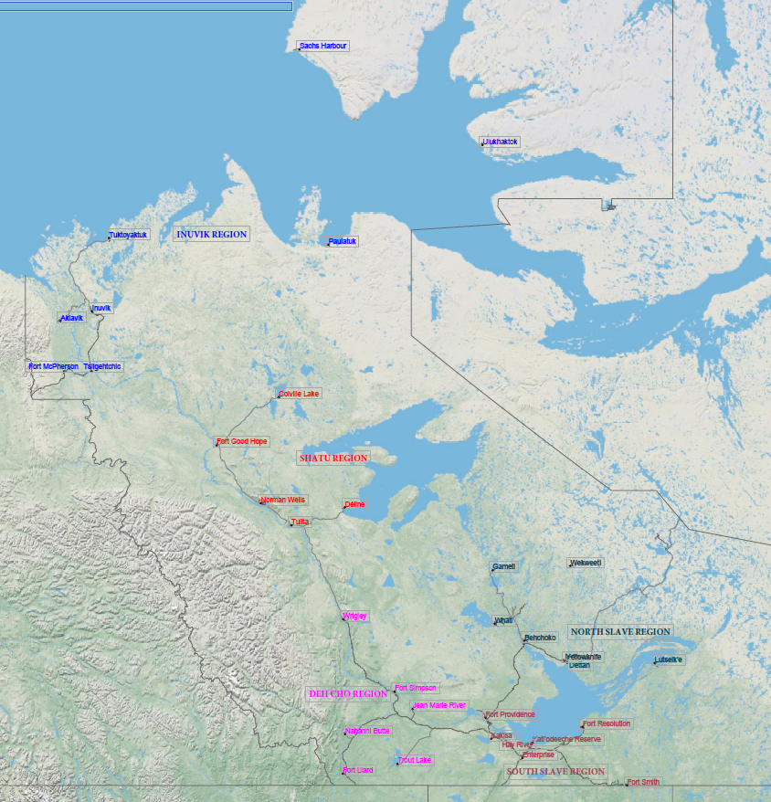
NWT Emergency Management Organization
INUVIK REGION
Staffing
Territorial:
2 full time
Surge capacity
Regions:
1 part time
Surge capacity
SAHTU REGION
NORTH SLAVE REGION
DEHCHO REGION
SOUTH SLAVE REGION

Slide 10
Concept of Operation
Federal/other government
Federal Emergency Response Plan / Mutual Aid Arrangements
Need Assistance
Provide Assistance
Territory
Need Assistance
NWT Emergency Plan
Region
Provide Assistance
Need Assistance
Community
Community Emergency Plan
Need Assistance
Provide Assistance
Individuals/Families
Individual and Family Emergency Plans

Slide 11
FREQUENCY
NWT Risk Profile
Likely to almost certain |  | Earth movement-permafrost degradation Weather-other extreme | Weather-winter storm Transportation accident Critical Infrastructure Failure-energy crisis | Fire/Explosion Flood
Probable |  | Earth movement -other Snow load hazard Ice hazard | Critical Infrastructure Failure - water contamination | Critical Infrastructure Failure-other
Unlikely | Food and agriculture emergency |  | Human disease Weather-wind storm | Industrial emergency Civil unrest
Very unlikely to rare |  | Falling debris | War/International incident | Earth movement- earthquake & tsunami
 | Low | Moderate | High | Very High
IMPACT
Notes:
The EMO maintains an updated territory wide Hazard Identification Risk Assessment (HIRA) to inform communities and GNWT departments of hazards specific to their environment. This information can be used in updates to territorial and community emergency plans, in the development of territorial or community disaster risk mitigation plans, to improve emergency response protocols and structures, and to guide the development of emergency response exercises, training and awareness.
The top five hazard risks in the NWT are:
Wildfire
Flood
Severe weather
Transportation incidents
Critical infrastructure failure

Slide 12
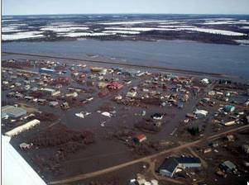
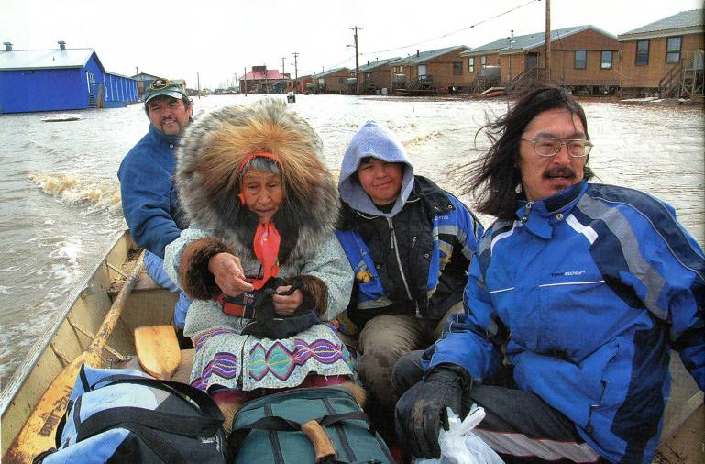
Emergency Events 2009-2019
Wildfires – 15
Air Incidents – 8
Critical Infrastructure Failure – 7
Flood – 4
Severe Weather – 4
Landslides – 3
Major Apartment Fire – 2
Marine Incident – 2
Dump Fire – 1
Environmental Spill – 1
Pandemic (2009) – 1
Epidemic – Animal – 1
Notes:
49 events over 10 years
Pictures 2006 Aklavik flood

Slide 13
NWT Emergency Plan Activations
Notes:
This chart illustrates how many emergency plan activations we’ve seen over the past five years, which doesn’t include events that were monitored or planning and preparation activities that help sustain the emergency management system.
You can see that wildfire emergencies, floods and power outages are well represented in this chart.
Other Category Incidents:
2012-2013 – Norman Wells Gas supply Shortage (January 2013)
A power outage caused a disruption to the natural gas flow for the Town of Norman Wells. This affected most of the residences and commercial/public buildings. The average temperature in Norman Wells through the day was -40 degrees and the Town declared a local state of emergency.
2016-2017 – Hay River Ammonia Leak (July 2016)
Several buildings in downtown Hay River have been evacuated because of an ammonia leak at the demolition site for the old recreation center.
2018-2019 – Other: Beaufort Delta blizzard (Sachs Harbour/Paulatuk), Rockridge Apt fire and evacuation, Hay River dump fire and highrise fire/evacuation.

Slide 14
Impact of Disasters in the NWT
2014: Wildfires – estimated at 20+ million
2012: Nahanni Butte flood – ~2 million
2008: Hay River flood – 460K
2006: Aklavik flood – 3.14 million
2005: Ft Good Hope flood – 648K
Over 26 million over 10 years in economic loss in the NWT
Notes:
Through the federal Disaster Financial Assistance Arrangements, the NWT has been fortunate enough to recover approximately $6 million in emergency response and recovery costs over the last number years, with more that $20 million still outstanding from the 2014 wildfire season response. At the end of the day, concerns are growing by Canada that the current arrangements for disaster assistance will become unaffordable in light of the expected increase is disasters and subsequent impacts and claims over the next 10 years.

Slide 15
Key EMO Program Activity
Chair of the Territorial Planning Committee and updating the NWT Emergency Plan
Monitoring, readiness and response to emergency events
Public Alerting and public communications
Assisting Communities update emergency plans (workshops/TTX)
Training and development – ICS for staff and key stakeholders
GNWT participation in emergency response exercises
Access to federal emergency management funding programs
Disaster Assistance Policy and DFAA

Slide 16
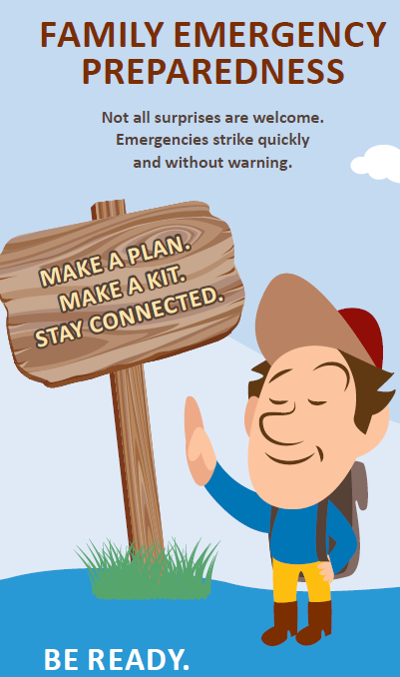
Questions

