Slide 1
After-Action Review
Guide for Community Governments
October 16, 2023
Based on WHO AAR Presentation
Notes:
Facilitation Guidance:
Maintain and unbiased perspective and use open-ended questions to guide the discussion.
Focus on learning. AAR is not an evaluation of performance but an opportunity to learn challenges and best practices.
Encourage people to give their honest opinions.
Encourage active participation by all participants, including silent participants.
Encourage groups to write legibly on cards, post-its, and flipcharts
Note Taker Tips:
The reporters should transcribe everything written on the cards, flip charts, sticky notes, during Session 1, 3, 4 and 5 in the provided templates.
You will receive a template for taking notes that is the same format as the sessions to help you record everything that is written. There is space to add additional narrative for inclusion in the report.
When additional information is discussed but not written by the group, be sure to save it for discussion during subsequent sessions.

Slide 2
Overview
What is an After-Action Review Process?
The purpose of an after-action review is to analyze the management or response to an incident, exercise or event by identifying strengths to be maintained and built upon, as well as identifying gaps, lessons, and best practices
A Tool for Facilitating Learning and Building Performance
An after-action review is a learning-based tool that will help your team make continuous improvements by bringing the relevant individuals to critically and systematically analyse actions taken to respond.
Notes:
Facilitator Notes:
An AAR seeks to identify
Actions that need to be implemented to ensure better preparation for the next event.
Highlight strengths which carried the event and should be recognized.

Slide 3
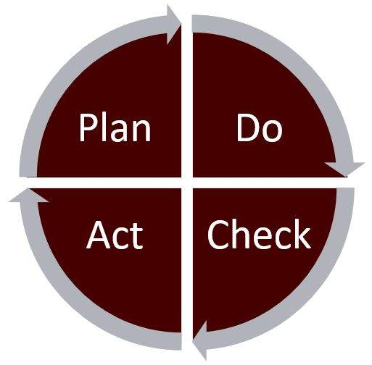
Continuous Improvement Cycle
Plan. Identify a risk or vulnerability and create a plan
Do. Implement or test the plan.
Check. Conduct an after-action review to analyze the success of the plan and identify areas for improvement
Act. Implement improvements based on what you learned in the after-action review.
Notes:
Facilitator Notes:
Why conduct an after-action review?
It is an opportunity to reflect on operations.
The process can help improve plans and identify training gaps
After action reviews identify areas of focus for future planning, training, and exercise development

Slide 4







AAR Principles
Participative
Space for experience sharing and
mutual learning
Open and honest spirit
Analysis of systems and processes
Oriented towards the identification
of solutions
A compilation of participants perceptions
Notes:
Facilitator notes: These are the key principles to remember while going through the exercise.

Slide 5

What an AAR is NOT
AAR is not:
An external evaluation of an individual’s or a team’s performance
An opportunity to criticize, blame, or judge individuals
AAR does not measure performance against benchmarks or key performance standards
Notes:
Facilitator notes: These are often areas that gather a lot of focus from participants and are not very beneficial to creating a better outcome in the future. Please remember these notes and refer back to them in required throughout the workshop.

Slide 6







Key Phases Carried Out During AARs
OBJECTIVE OBSERVATION
ANALYSIS OF GAPS & BEST PRACTICES
AND CONTRIBUTING FACTORS
Establish how actions were implemented during the response,
in contrast to how they are supposed to or normally happen, according to plans and procedures.
Identify the gap between planning and practice.
Analyse what worked well and what worked less well and why.
IDENTIFICATION OF
AREAS OF IMPROVEMENT
Identify actions to strengthen or improve performance
and how to follow-up.
Notes:
Facilitator notes: This is a general overview of what will be accomplished throughout the AAR Workshop.

Slide 7
Overview of the Response
Notes:
Facilitator provides an overview of the response/disaster that occurred to set the topic for the After Action Review.

Slide 8
Working Groups Composition
Group A | Group B | Group C | Group D | Group E | Group F
Notes:
Facilitator assigns participants to working groups (minimum of 3 persons per group, a maximum of 6 persons per group). Sometime there may be a desire to complete the whole exercise as a single group (especially if there are not a lot of members in attendance) which is okay too!

Slide 9

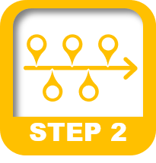



AAR Overview - 5 Steps
Step 1 : What was in place before the response?
Step 2 : What happened during the response?
Step 3 : What went well? What went less well? Why?
Step 4 : What can we do to improve for next time?
Step 5 : The Way Forward
Notes:
Facilitator note: These are the 5 steps that will end with a completed AAR and are the main focus for this workshop.

Slide 10

Step 1 : What was in place before the response?
Working Groups
Duration: 20-30 min
In your groups identify the capacities that were in place prior to the event to support an emergency response.
Make a list of these capacities by using the 5 categories below :
  Plans and procedures
  Coordination mechanisms
  Resources
  Preparedness activities
  Other
WRITE ALL OF YOUR GROUP’S ANSWERS ON INDIVIDUAL
STICKY NOTES
Discuss each item to ensure all members of the group
are aware of them and how they should function.
What existed
Regardless:
if it worked or not
If it was used or not
Notes:
Facilitator notes:
The purpose of this activity is to get group members to be aware of all of the items that are currently in place in the event of another emergency. As an emergency has multiple stakeholders, there may be group members who are unaware of what other areas have that may be useful. This is to help to share information between all of the participants to keep everyone on the same page.
*** Show the next slide before you begin the activity so that the group can see an example***

Slide 11
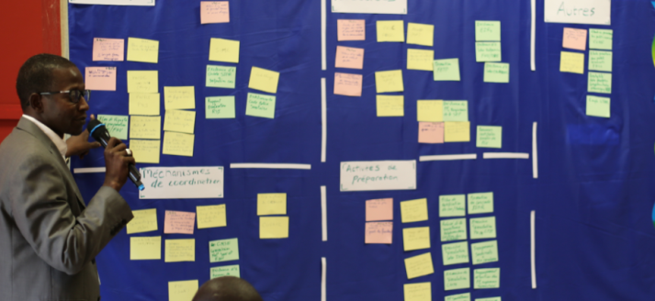
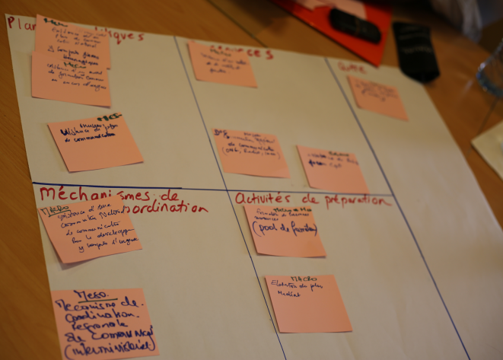
Step 1 : What was in place before the response?
Use of cards to identify capacities
Each group compiles capacities by categories
Plans and procedures | Resources | Other
Coordination mechanisms | Preparedness activities
Consolidation
With all participants
Examples:
Contingency Plan
Cot & Blanket Stockpile
Separate funding or budget for emergency response.
An emergency communication plan
An annual simulation exercise for some of the group members
Evacuation or Hosting Plan
Notes:
This is an example for the groups to further understand how the activity will play out.

Slide 12
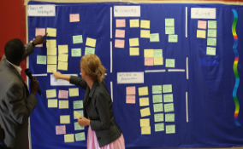
Step 1 : What was in place before the response?
Grouping themes with all participants
Duration: 20-30 min
Grouping of all capacities identified on a large table on the wall
Remove duplication, agree on dates and add new cards as needed
Notes:
This session forms the baseline for the analysis, do not hesitate to come back to it in the next sessions. This also allows all participants to understand and be aware of the resources currently available for emergency response activities.

Slide 13
Step 2 : What happened during the response?
Building a timeline of what actually happened by mapping out key milestones of the emergency and to order them in chronologically
Objectives of building a timeline:
To establish a common picture of the major milestones of the emergency and response actions taken;
To initiate discussions and look-back on the emergency;
To understand timeliness of key actions taken
Notes:
**Need to define what the time period for this is timeline is prior to the beginning of the exercise. **

Slide 14

Step 2 : What happened during the response?
Water level exceeds markers for second trigger point; affected residents are instructed to evacuate to local evac centre
Water Levels Decrease
Unaffected residents can return to community
LEMO Activation
April 20, 2023
April 22, 2023
April 26, 2023
May 4, 2023
April 21, 2023
April 23, 2023
April 30, 2023
May 5, 2023
Reports of water level rising
Water levels reach first trigger point; set up on local evacuation centre
Water level reaches final marker; triggering SOLE and community wide evacuation coordinated with REMO and TEMO
Specialists arrive in community to assess damage

Slide 15
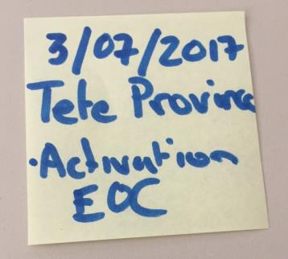
Step 2 : What happened during the response?
Individual Work
Duration: 10 Min
  Each participant should write on different post-its 3 key milestones which happened during the event.
One milestone per card:
  Date
  Description of the event
  Location
Examples
Water Level Monitoring
Activation of EOC
State of Local Emergency Declared
Water levels reach trigger points
Request for assistance for evacuation
Set up Local Evacuation Centre
Evacuee Registration Begins
Communications distributed for evacuees

Slide 16
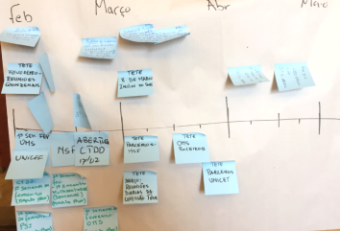
Step 2 : What happened during the response?
Working Group
Duration: 15-20 min
Group all the post-its into one comprehensive timeline Remove duplication
Agree on approximate dates
Fill in gaps with new post-its

Slide 17
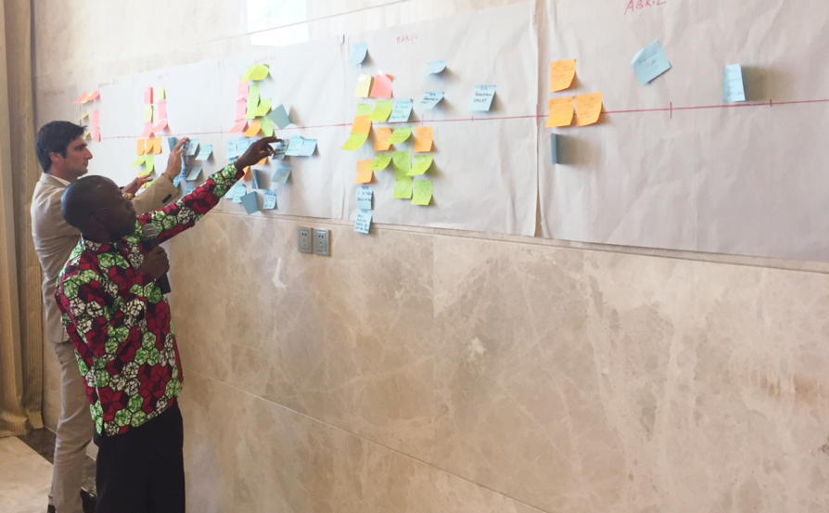
Step 2 : What happened during the response?
Timeline Overview
Duration: 20 min
Identify spokesperson to walk through timeline
Fill in any missing activities
4 TIMELINESS METRICS
Time to detection
Time to LEMO activation
Time to inform residents
Time to response

Slide 18





Step 3 : What went well? What went less well? Why?
CONTRIBUTING
FACTORS
STRENGTHS
&
CHALLENGES
of the response
Notes:
Now we will move to talk about strengths and weaknesses and what contributed to each.

Slide 19


Step 3 : What went well? What went less well? Why?
CHALLENGES
5 WHY’s
STRENGHTS
LIMITING & ENABLING
FACTORS
IMPACTS
IMPACTS
CAUSES
CAUSES
CAUSES
CAUSES
CAUSES
CAUSES
Notes:
The “5 Whys method” is the simplest and most frequently used approach to root cause analysis. In essence, the facilitator repeatedly asks “Why?”, to progressively unpack causative factors and thus get to the root cause of a particular issue. This technique is the most appropriate in the frame of an AAR group discussion.

Slide 20

Step 3 : What went well? What went less well? Why?
Conclusion: the root cause is a communications issue between communities and community members.
One of the biggest issues was that we couldn’t house all of the evacuees
People left feeling unsafe and without shelter
The 5 WHY’s
1
Why didn’t you house all of the evacuees?
5
Well, we weren’t able to.
Why? Numbers had been provided, no?
Yes, but they weren’t accounting for people who left without advising anyone
2
Why is that? Didn’t you have an evac centre set up?
4
Why was that?
Why didn’t you use the evac centre?
Yes, we did
3
We thought there was less people coming to the community
Actually, we did, but we didn’t have enough cots
Notes:
Facilitator Notes: This is an example of how to get through the 5 Why’s to determine the root cause of an issue.

Slide 21
Step 3 : What went well? What went less well? Why?
Working Group
Duration: 1 hour
Identify the challenges and strengths during the event.
For each challenge and strength, identify the impact this has had on the response.
For each challenge and strength, work to determine the root cause.
Write down and work through 3 challenges and 3 best practices
Notes:
Encourage the groups to take some time to look at the sticky wall activities ‘what was in place?’ and ‘the timeline’ in order to identify challenges and strengths. E.g. if the timeline includes regular meetings with Local EMO, is this a strength that should be identified? Similarly, if there were no regular LEMO meetings, did this lack of regular communication put an hindrance on the response?
Example Challenges
(Winter power outage): Could not find a way to heat all the homes safely
One person was doing all the work and could not manage everything
We couldn’t make sure that everyone was accounted for (public communications)
Example Strengths
Volunteers for door knocking was streamlined and efficient
Emergency communications protocols worked very well
The logistics team could get everything they needed in a timely fashion.

Slide 22
Step 3 : What went well? What went less well? Why?
Strengths | Impact(s) | Factors
 |  | Relationship had been established prior to the response Willingness of all stakeholders to undertake regular meetings Emergency plan were discussed prior to an event
Local EMO meetings
Improved coordination and sharing of information for the early detection and response for emergency event
Challenges | Impact(s) | Factors
Public Communications | Response was not coordinated between partners. Duplication of activities and effort. Time consuming and were not able to track who had been contacted (danger to human life) | Lack of Local EMO coordination and awareness of responsibilities for members No emergency communications plan in place.

Slide 23

Step 3 : What went well? What went less well? Why?
Remember the objective is:
To identify the strengths and the key challenges
but also
To identify gaps and recognize any
new capacities
developed during the response
e.g. new SOP, new equipment purchased, new skills learned,…
NEW

Slide 24

Step 4 : What can we do to improve for next time?
To help ensure that the same issues don’t occur during the next event, it is essential to develop a strategy to manage the strengths and challenges that have been identified.
Address Challenges
Highlight strengths to build on.
Develop Specific Activities:
to build on strengths
to address and mitigate challenges
Notes:
Facilitator: Now we can turn out minds to identifying what improvements can be made for next time. We make or update our plans in order to address challenges and to build on strengths.

Slide 25
Step 4 : What can we do to improve for next time?
Activity
Activity: Conduct a half day of training for Local EMO members on EOC essentials and to determine roles during a response. | Key Steps for Implementation: Determine date/location for training. Determine goals to achieve for training. Find training instructor. Create or Procure training materials.
Deadline: Dec 31, 2024 | Goal: # of people trained who can manage roles on a team General understanding of roles and responsibilities and who sits on the LEMO
All activities need to be practical and realistic
Several activities might be necessary to address a single challenge or a strengths
Not all strengths or challenges need an activity
Notes:
Facilitator: In order to do a better job we need to know:
What activity would make improvements?
What are the steps?
When should we do this by?
What is the final goal?
See the example. Keep in mind, these should be realistic and achievable.

Slide 26
Step 4 : What can we do to improve for next time?
Working groups
Duration: 45 min
Referencing the challenges and strengths we identified before, identify activities we could undertake to improve things for next time.
Maximum of 5 activities. For each:
  What is the activity?
  What are the steps?
  When should we do this by?
  What is the final goal?
POST THE ACTIVTIES UP ON A WALL WHEN YOU ARE DONE
Notes:
Facilitator to review the posted activities with the group at the end.

Slide 27

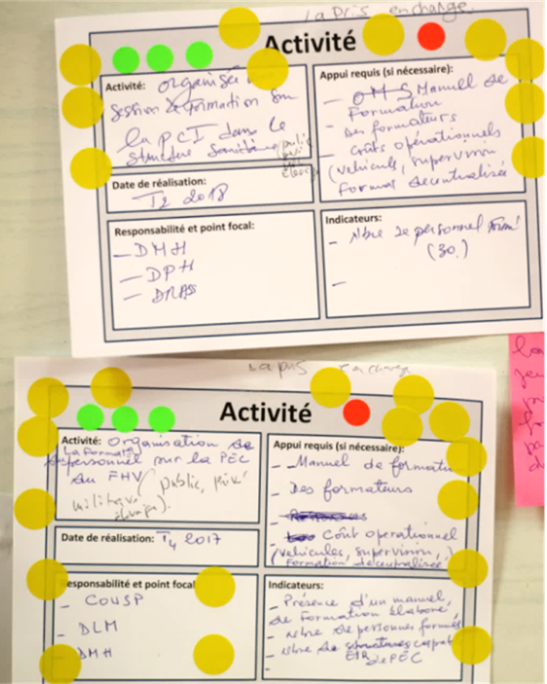
Step 5 : The Way Forward
Working Group
Duration: 20 min
1. All participants get 5 votes each. Votes are indicated by the stickers provided (1 sticker = 1 vote)
2. Each participant can vote on the activities that they believe should be the priority. You can use all your votes on one activity if you’d like or you can split them up.
3. Once everyone is finished voting, you can see which activities need to be priorities.
Notes:
The one with the most dots has is the top priority!

Slide 28
Step 5 : The Way Forward
Group work
Duration: 45 minutes
By group propose answers to each of the following questions?
What are the challenges in implementing the activities identified during this workshop?
What can be done to ensure the implementation of the activities identified during this workshop?
Take time to assign individuals/groups and confirm deadlines for activities to be completed and record it on the flip chart.
Notes:
The facilitator should now have the information to completed the After-Action Review report. Take photos of all of the activities and charts to ensure that responsibilities are recorded.

